Slide 1
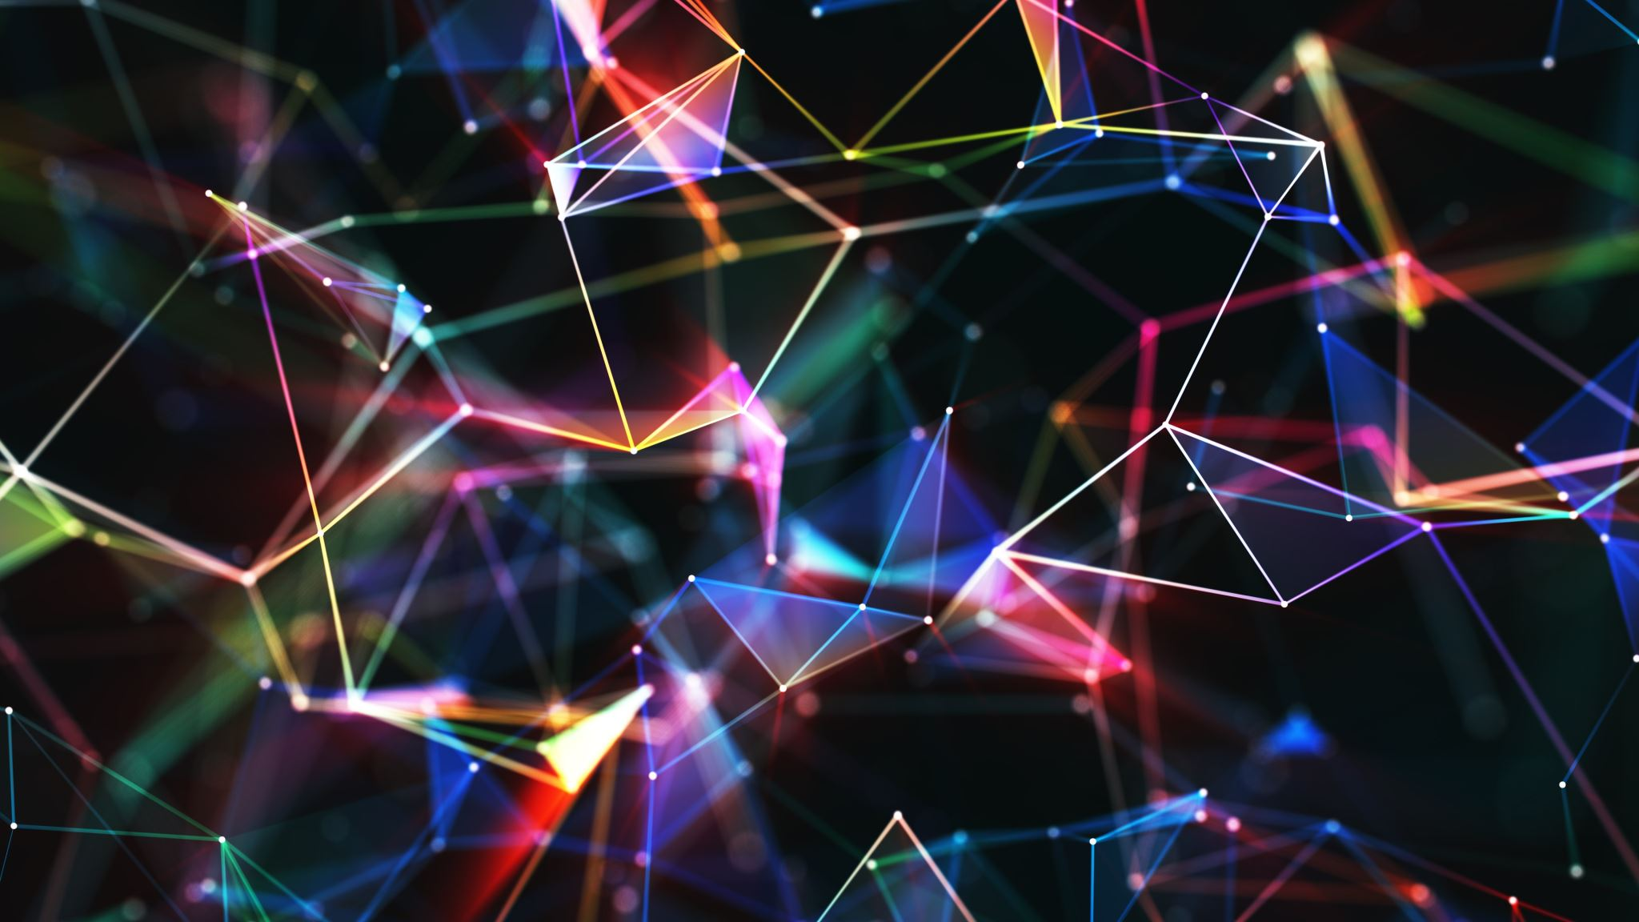
CYBERSECURITY LANDSCAPE IN 2020

Slide 2

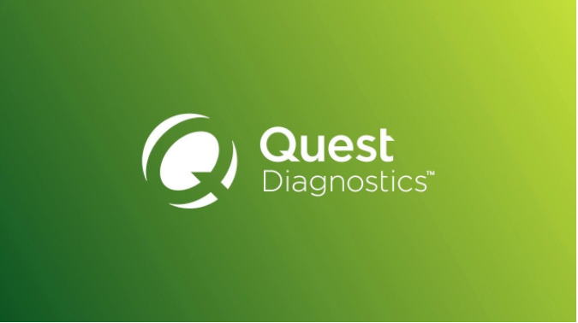

Introduction
Over the last few years, cyber-attacks have been increasing both in frequency and sophistication. In 2019 , we witnessed a surge in cyber-attacks and many companies were suffering a huge financial and reputational loss.
Some notable breaches:
Facebook
540 million user records
Quest Diagnostics
12 million patient records
Capital One
106 million user records

Slide 3
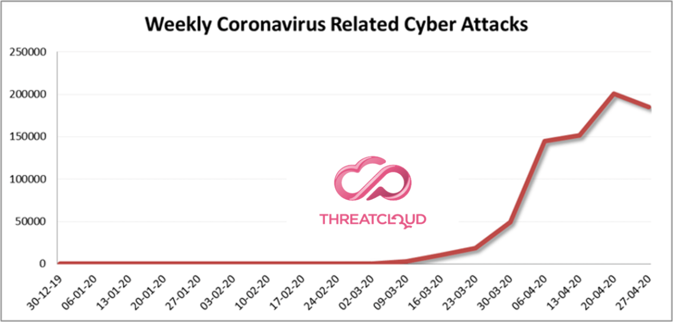
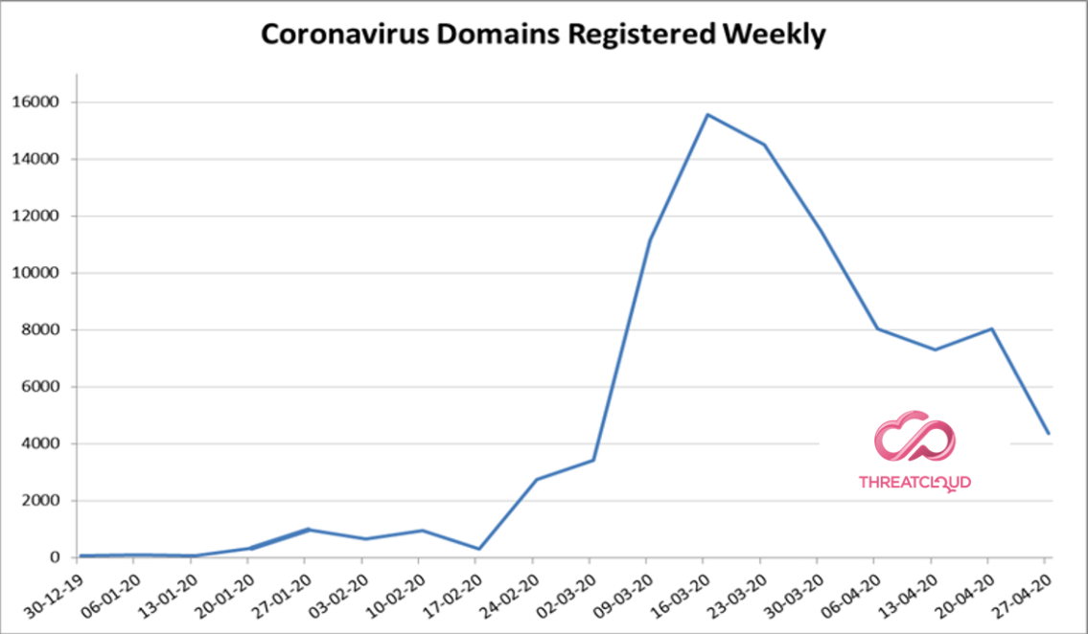
2020 and COVID-19 Pandemic
For organizations and individuals: Adapting to new practices such as social distancing, hand washing/sanitizing and remote working.
For cybercriminals: a novel opportunity for exploitation
Reference: https://blog.checkpoint.com/2020/05/12/coronavirus-cyber-attacks-update-beware-of-the-phish/

Slide 4
Lets look at the trends in the cybersecurity space that have emerged this year..

Slide 5
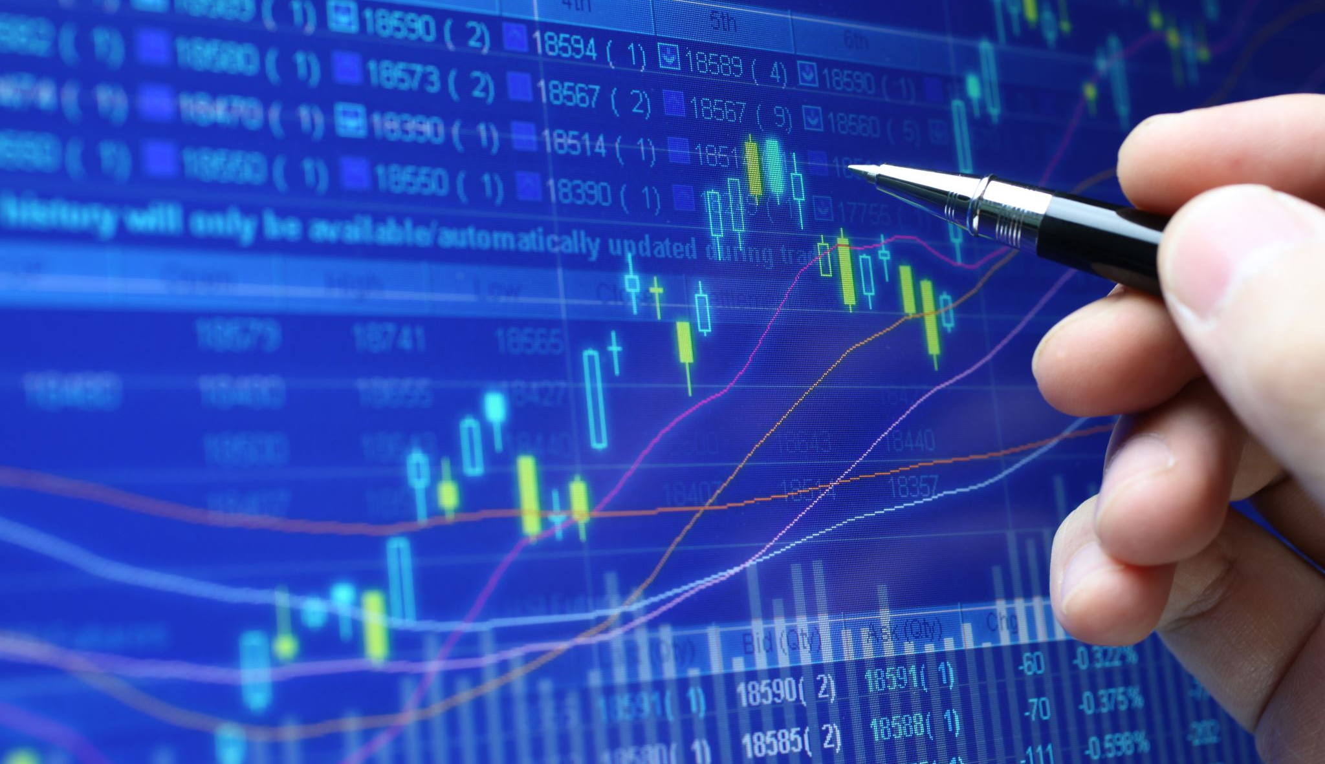
Digital transformation leading to faster cloud adoption

Slide 6
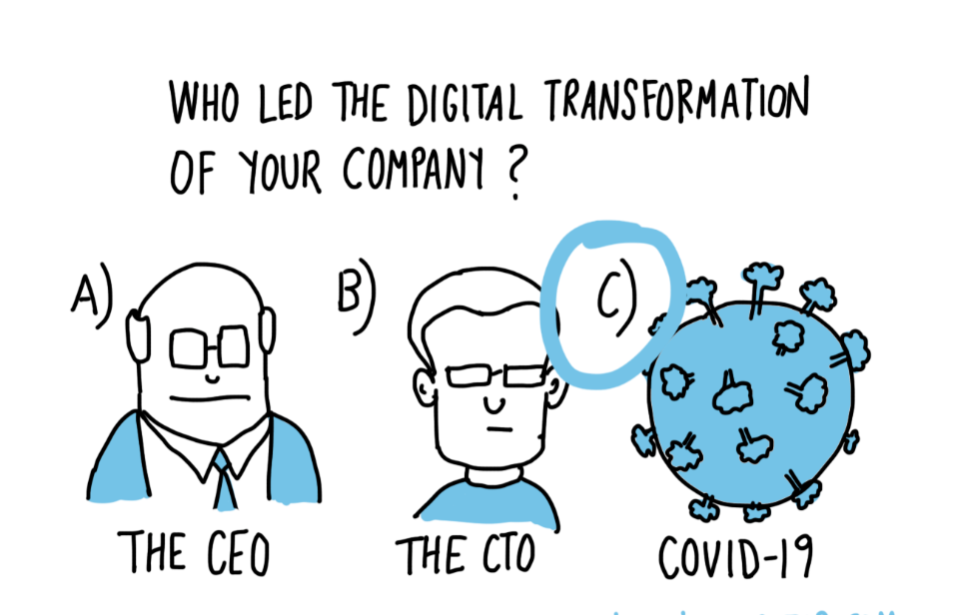

Slide 7
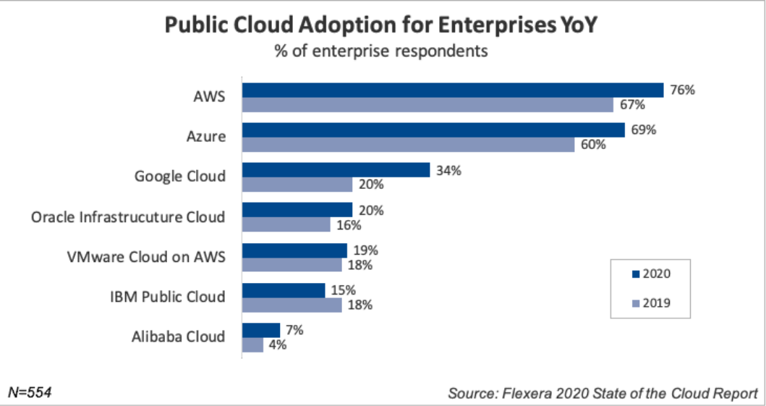
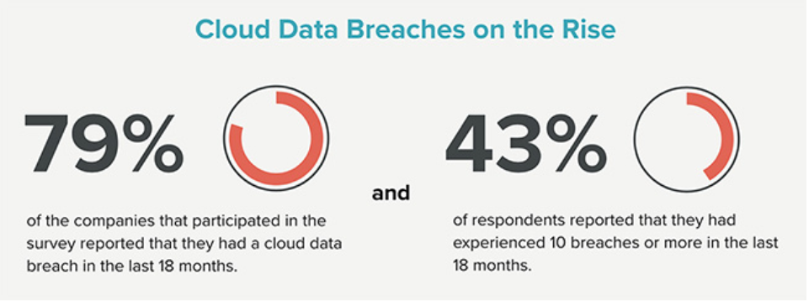
Faster adoption of cloud technologies due to digital transformation
Lack of proper controls in cloud due to hurried transformation
Ref:
https://www.flexera.com/blog/industry-trends/trend-of-cloud-computing-2020/
Ref:
https://www.helpnetsecurity.com/2020/06/03/cloud-data-breach/

Slide 8
Security risks in Cloud
Security misconfiguration
Excessive access permissions may go unnoticed
Ddos attacks
Malware infections
Compliance violations

Slide 9
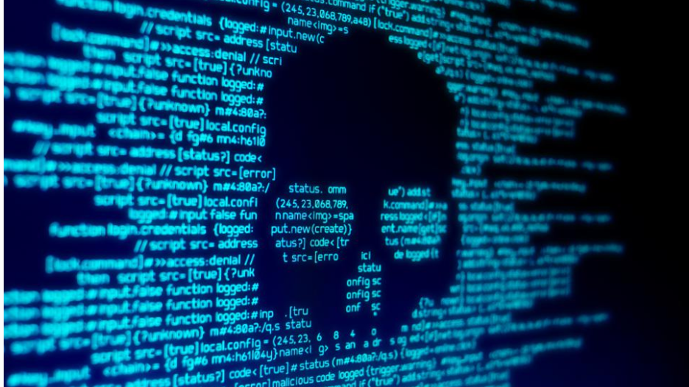
Increase in Phishing ,Malware and Ransomware

Slide 10
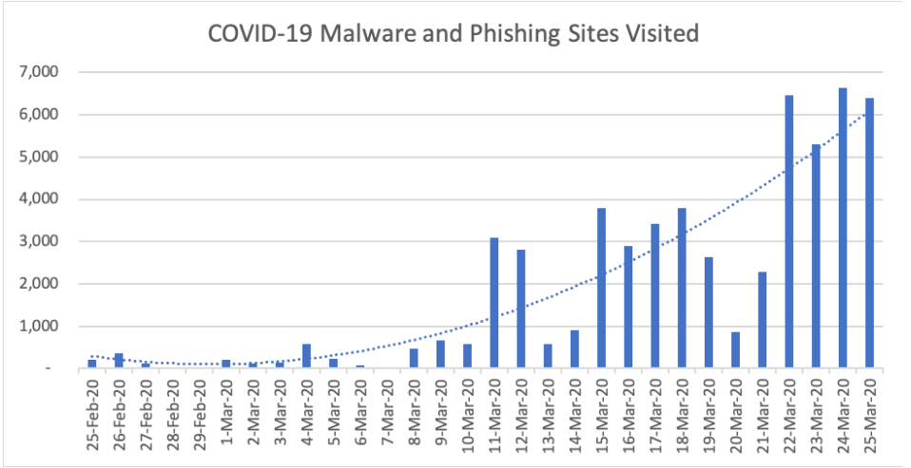
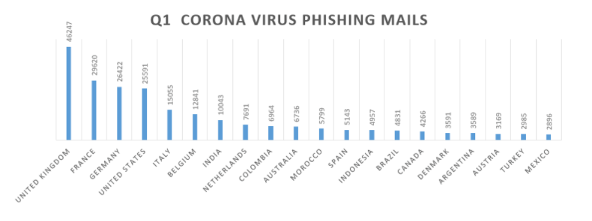
COVID-19 offers criminals perfect bait for creating phishing mails and malware campaigns
More number of infected personal computers and phones.
End users being tricked into downloading ransomware disguised as legitimate COVID-19 applications
Ref : https://www.menlosecurity.com/blog/sophisticated-covid-19-based-phishing-attacks-leverage-pdf-attachments-and-saas-to-bypass-defenses
Ref : https://success.trendmicro.com/solution/000247621-Coronavirus-COVID-19-is-being-used-in-email-Spam-attacks-Malware-and-other-Scams

Slide 11
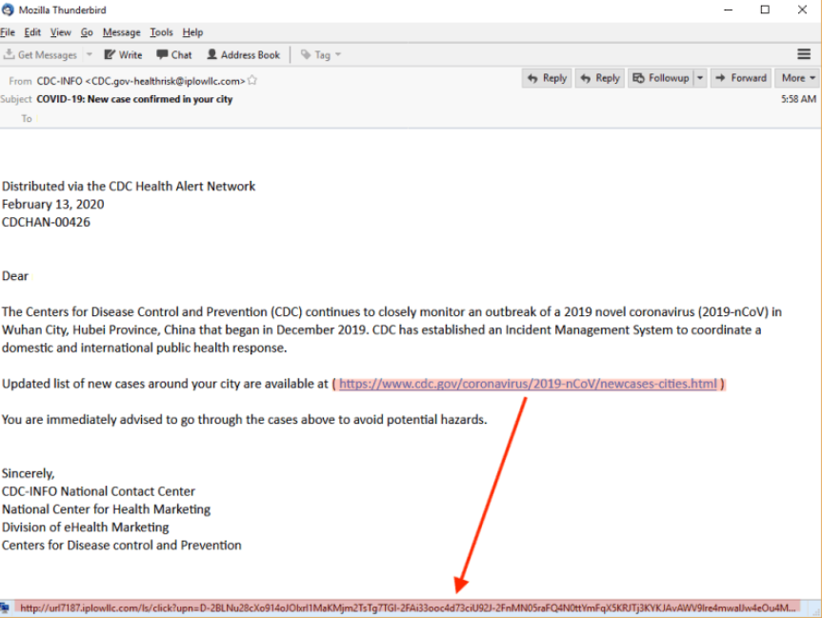
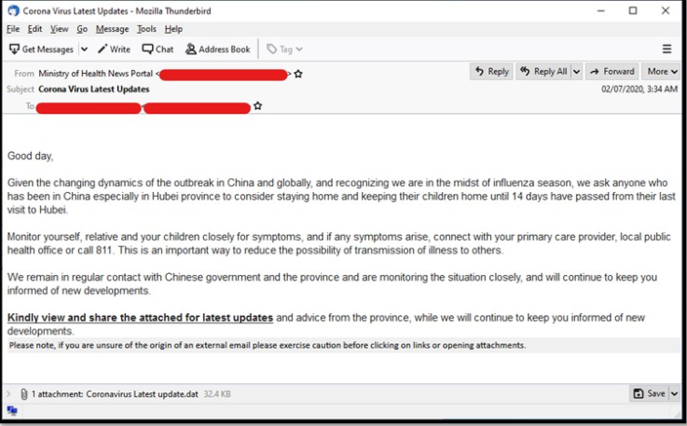
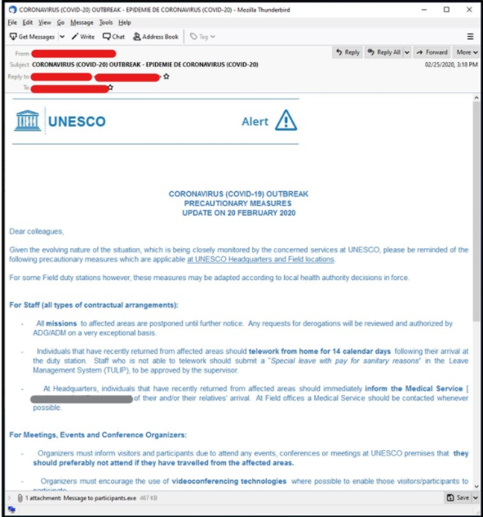
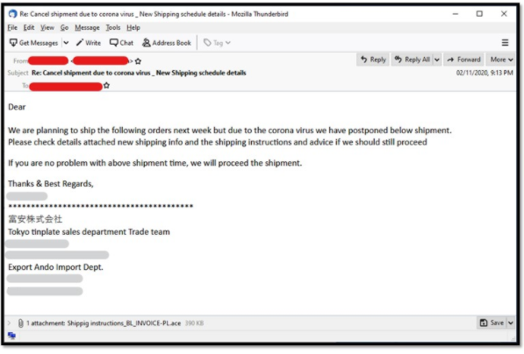
Phishing Mails

Slide 12
Defense strategies
User awareness
Backup and recovery strategies
Vulnerability and patch management processes
Use of privileged accounts and access controls
Content and Whitelist filtering
Security configurations of endpoints
Incident response processes
Use of threat-intelligence solutions

Slide 13

Increasing usage of Mobile Devices

Slide 14
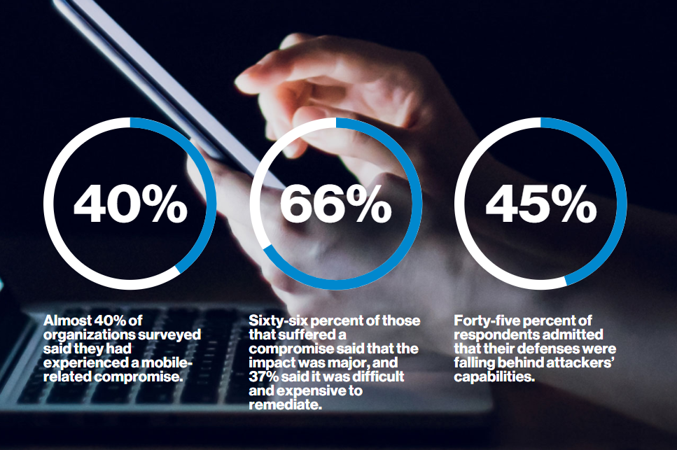
Employees routinely access corporate data from smartphones
Apps are often downloaded with no concern for security at all. One such app is the Chinese-developed TikTok, which has been found to have many vulnerabilities
In 2014, Kaspersky detected almost 3.5 million pieces of malware on more than 1 million user devices.
Ref : https://enterprise.verizon.com/resources/reports/mobile-security-index/

Slide 15
Security Risks associated with Mobile devices
Data Leakage
Unsecured Wi-Fi
Network spoofing
Phishing Attacks
Out of date devices
Broken Cryptography
Cryptojacking attacks
Poor Password hygiene

Slide 16
Defense strategies
Resilient Authentication Measures like Multi-factor authentication (MFA).
Routine Updates and Backups
Blocking Suspicious Apps and Avoiding Public Wi-Fi
Monitoring and Wiping of Devices

Slide 17
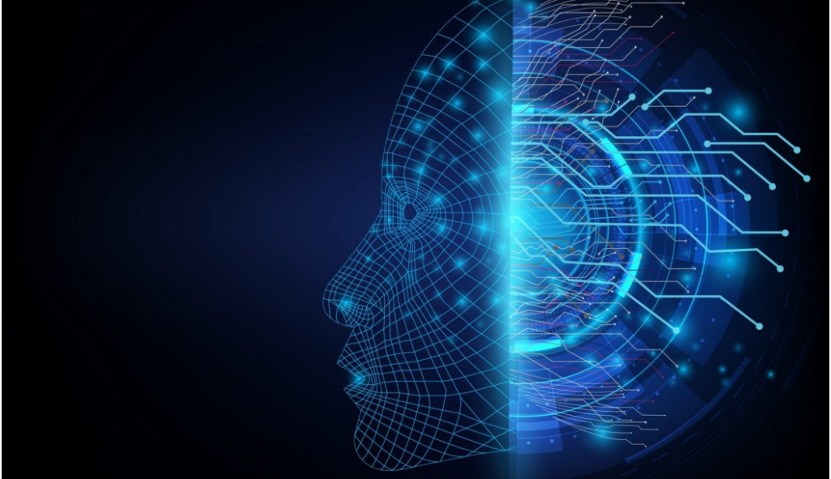
The continued rise of AI

Slide 18
Most commercial software contain Artificial Intelligence(AI) and Machine Learning (ML).
They analyze existing data, take action, and make predictions based on the data they have.
AI accelerates the identification of new threats and responses to them and can help to block cyberattacks
But the same technology can be used by cyber criminals, to develop sophisticated attacks

Slide 19
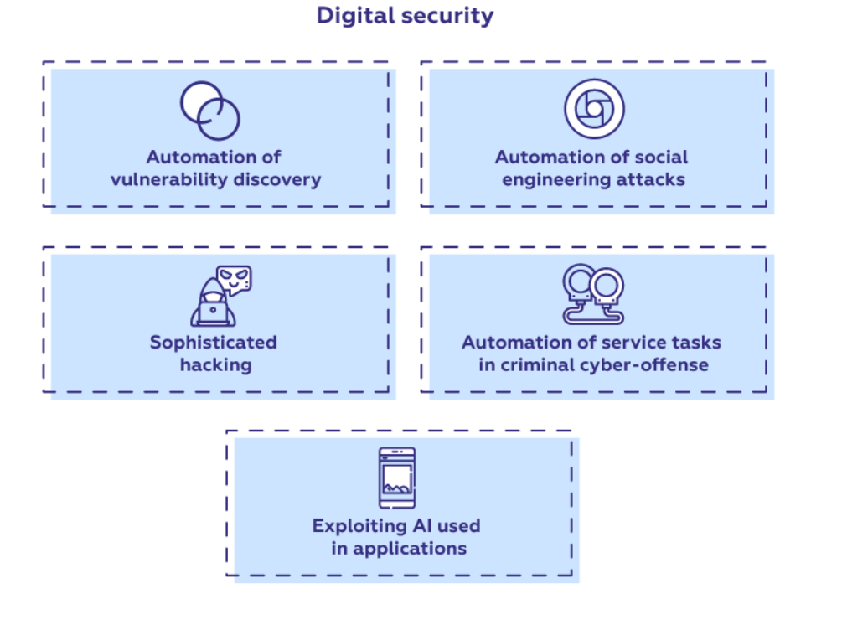
Security risks posed by AI/ML
AI-based tools are available and easily manipulated for nefarious purposes.
Many of the powerful ML frameworks are available as-a-service which can help in development and testing of AI based attacks
Bots powered by AI and ML can be used to find system vulnerabilities faster and then exploit them in real-time.
AI/ML is also used to create more effective malware and run customized phishing campaigns
Ref: https://medium.com/sciforce/artificial-intelligence-for-cyber-security-a-double-edge-sword-6724e7a31425

Slide 20
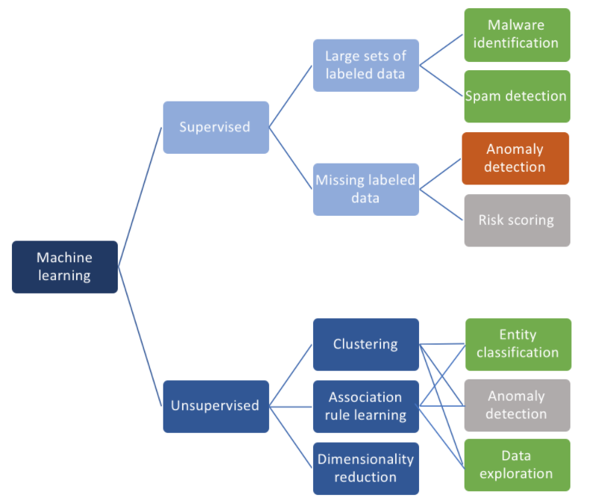
Defensive AI/ML
Can be used to identify anomalies and suspicious patterns
Automatic updates to existing software based on sophisticated analysis by AI/ML
AI/ML based malware detection looks at the characteristics of malware rather than a specific signature.
Can be employed to automatically identify sensitive information or unusual activity.
Ref: https://towardsdatascience.com/ai-and-machine-learning-in-cyber-security-d6fbee480af0

Slide 21
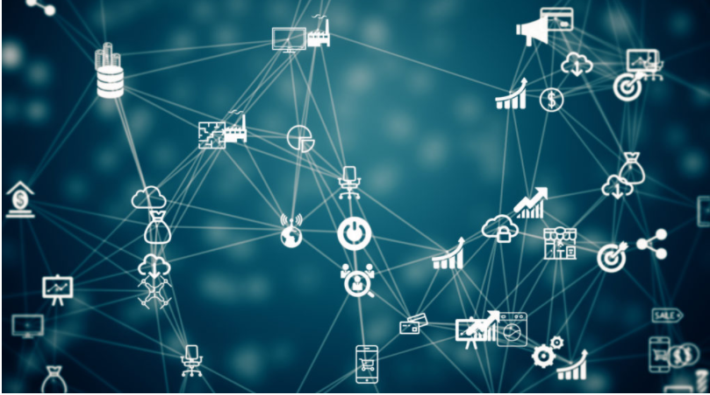
IOT: more devices, more risks

Slide 22
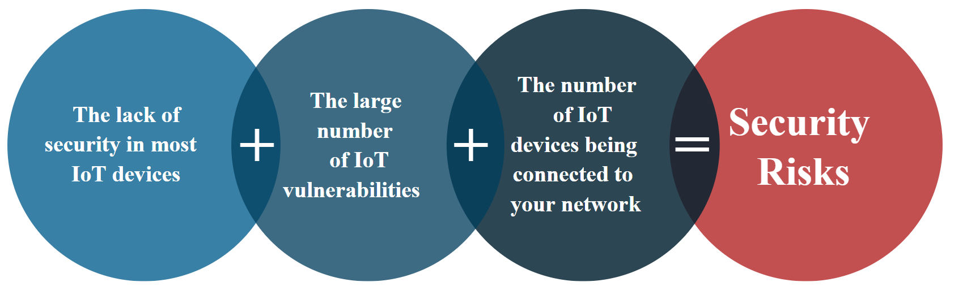
Sharp rise in IoT devices and connections and the COVID-19 pandemic
The impact of an IoT botnet attack on consumer versus industrial devices is vastly different.
An attack on a consumer gadget could be limited to a privacy issue, whereas the effect of a successful breach on a manufacturing device can have a significant production or safety cost.

Slide 23
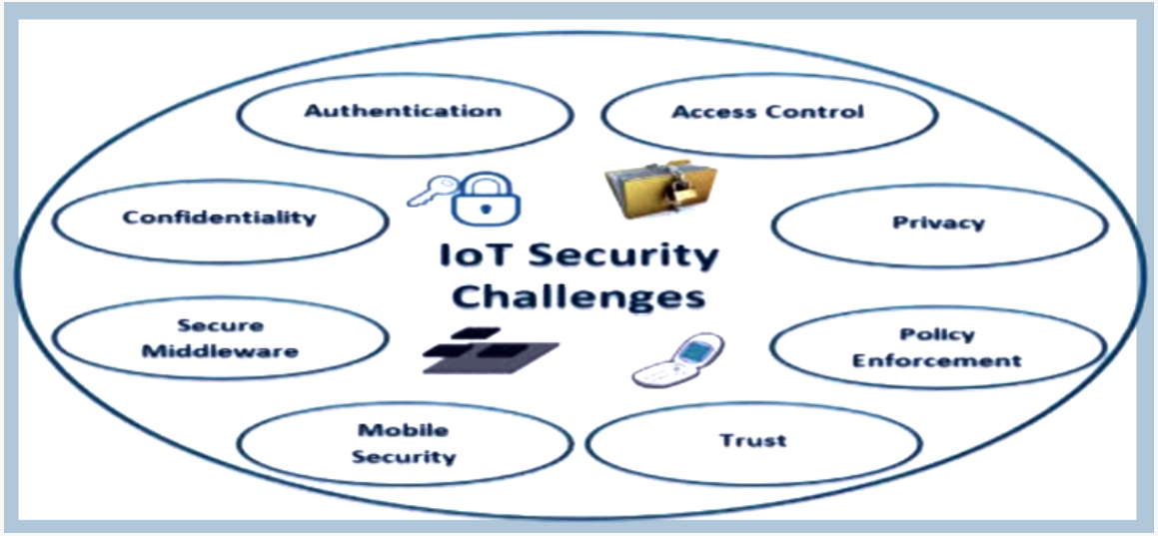
Security Risks in IoT
Insecure deployment of IoT
Lack of security updates for IoT devices.
Devices with no password or a standard, hard-coded default password
Encryption not being built into IoT devices

Slide 24
Defense strategies for IoT
Changing or updating default passwords
Maintaining separate corporate network from vendor-managed and unmanaged IoT devices
Preventing IoT devices from communicating outside the organization
Removing unsupported operating systems, applications, and devices from the network

Slide 25
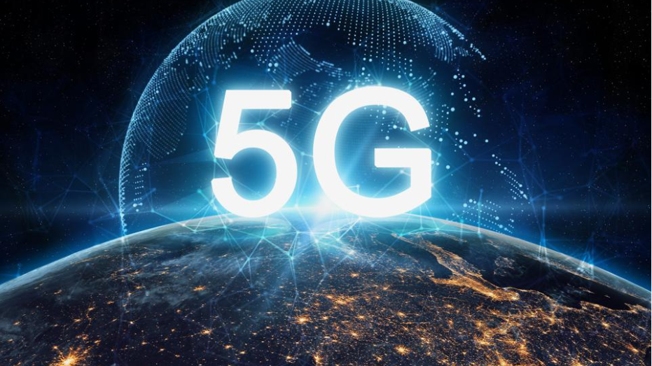
Implementation of

Slide 26
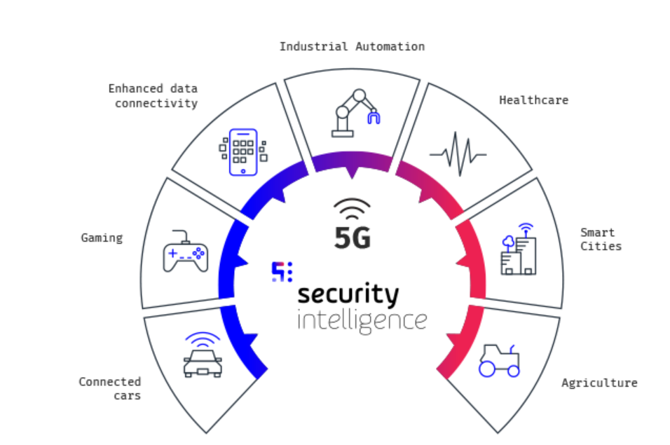
Due to increased bandwidth enabled by 5G technology explosion of data volumes and the number of connected devices
Expected to be as much as 100 times faster than the present 4G systems, with up to 25 times lower latency or lag time, and as many as one million devices supported within one square kilometer
The evolution, development and connectivity of numerous systems within 5G opens the door to numerous threats.
Ref:https://www.mobileum.com/solutions/5g-solutions/5g-security/

Slide 27
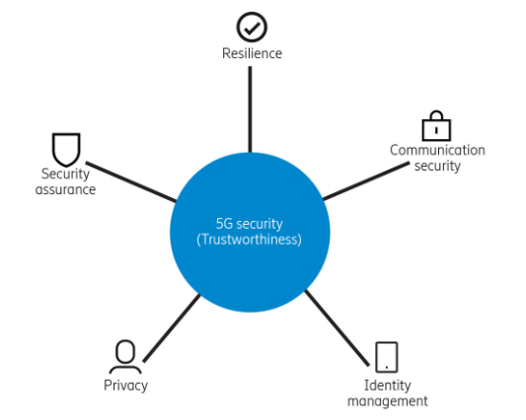
Security Risks of 5G
Vulnerabilities of telco services and infrastructure
Communications towers with closer proximity, which increases the risk that of tracking precise location of users
Due to increased interconnectivity service providers will have extensive access to large data sets sent by user devices.
IoT devices are expected to occupy the 5G network bandwidth, and the interlinkage of all these devices in the 5G network will reveal previously unknown problems in the design and behavior of 5G.
Ref:https://www.ericsson.com/en/news/2018/3/5g-security

Slide 28
Thanks all!

Slide 29
Q&A

